Slide 1
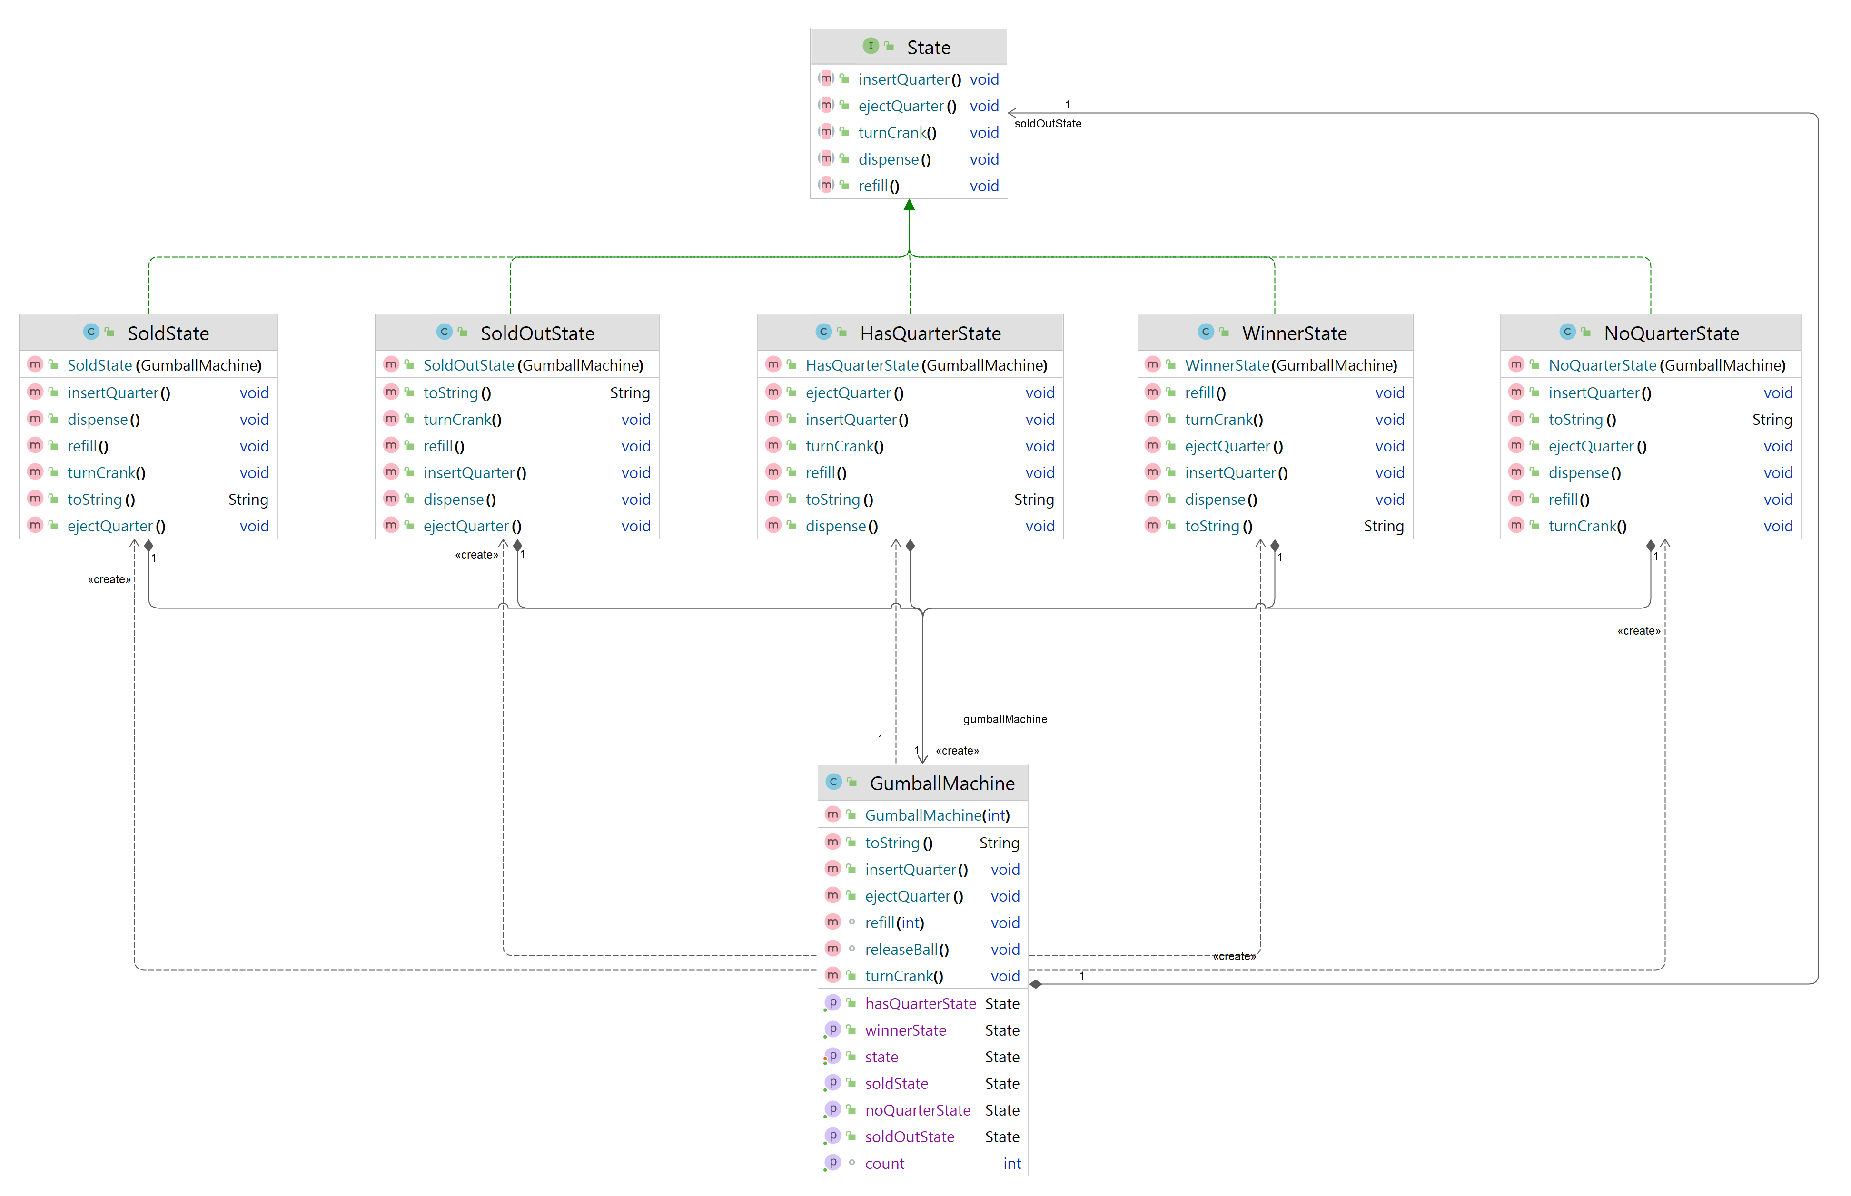
State
Concrete State
Context

Slide 2
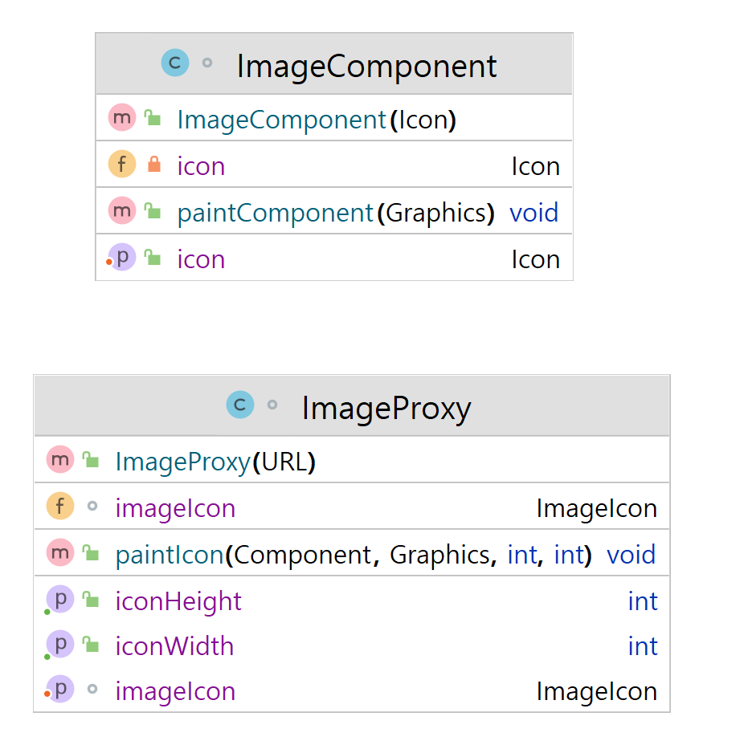
Subject
Icon <<interface>>
Proxy
Real Subject
ImageIcon

Slide 3
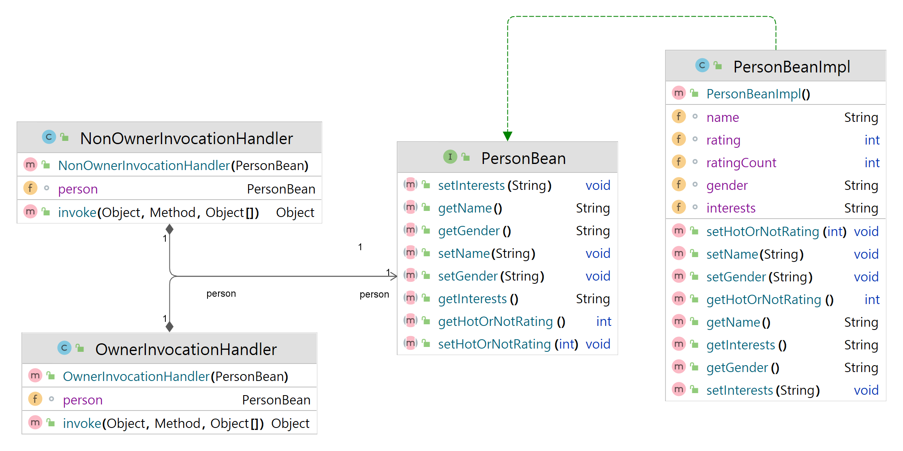
Subject
Real Subject
InvocationHandler
InvocationHandler <<interface>>
Proxy
PersonBeanlmpl

Slide 4
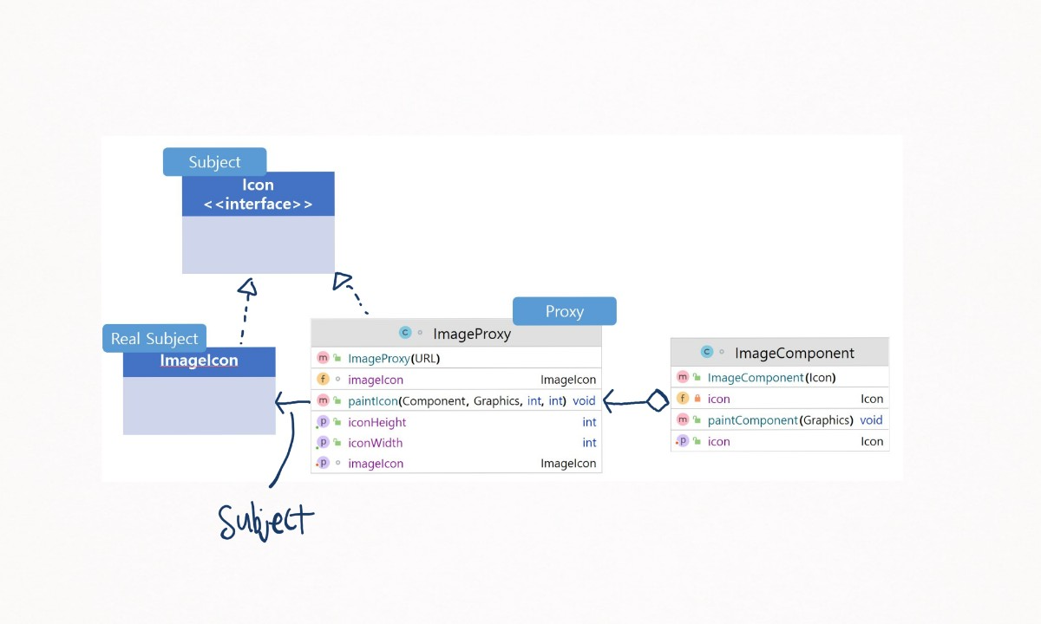

Slide 5
